Slide 1
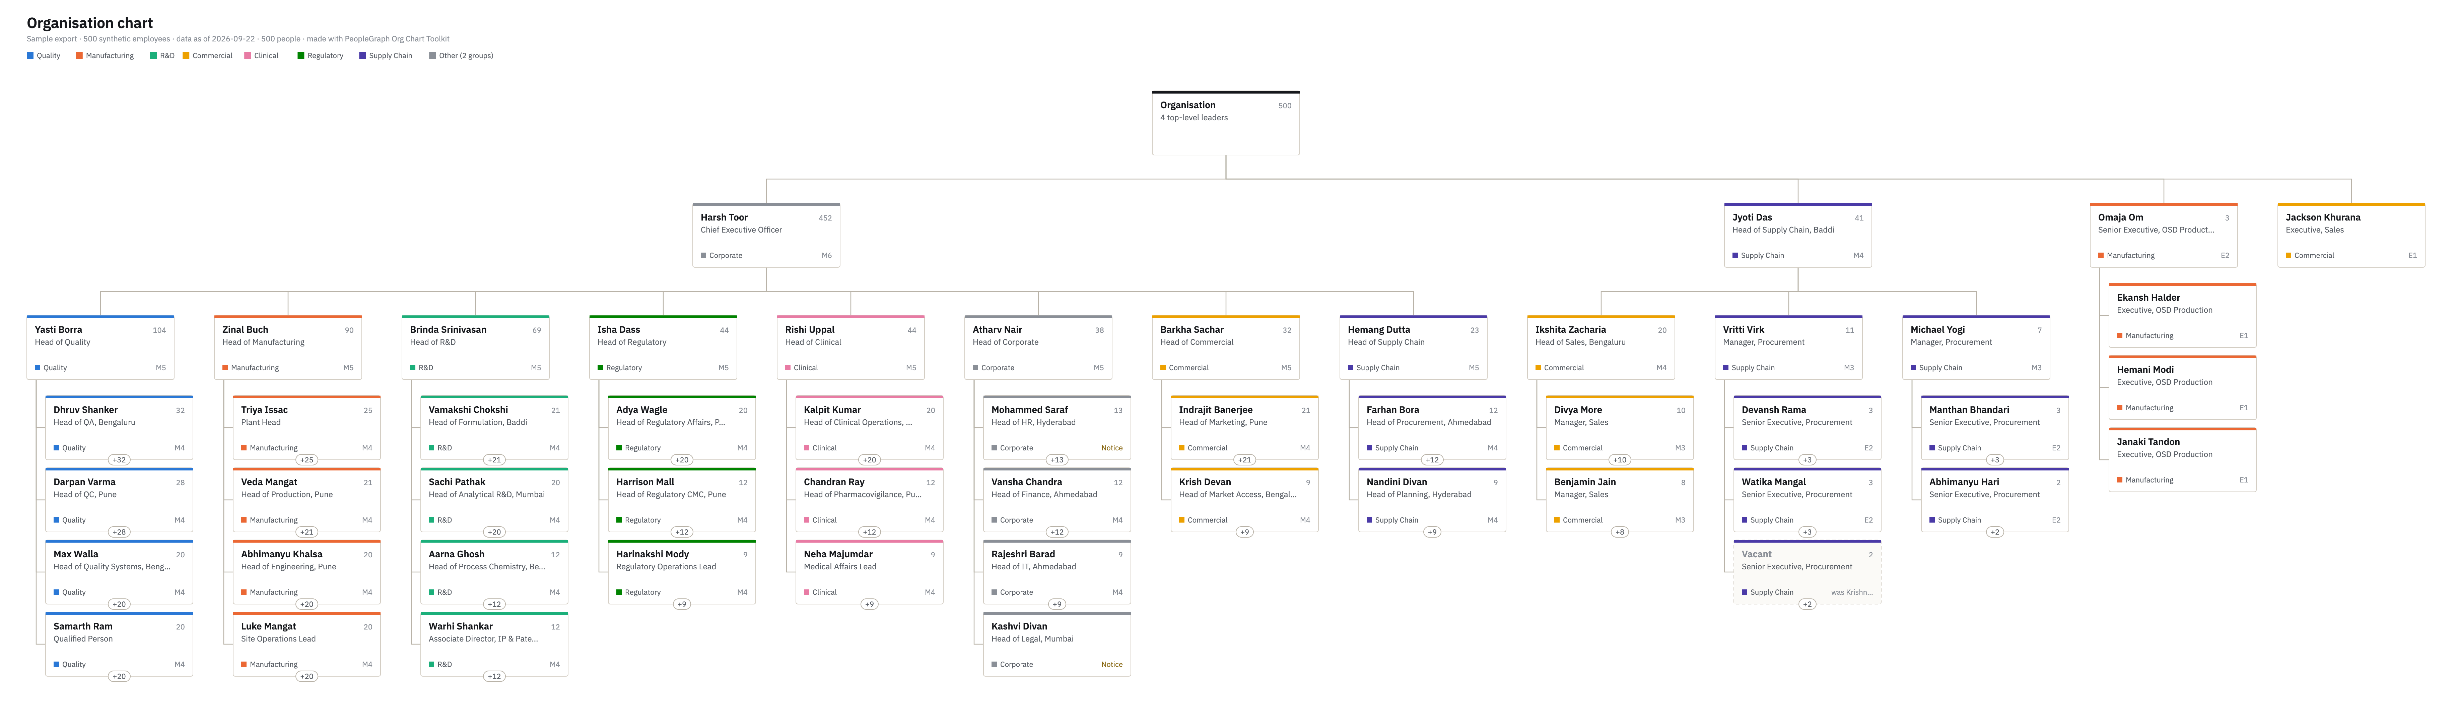
Organisation chart
Sample export · 500 synthetic employees · data as of 2026-09-22 · 500 people · made with PeopleGraph Org Chart Toolkit

Slide 2
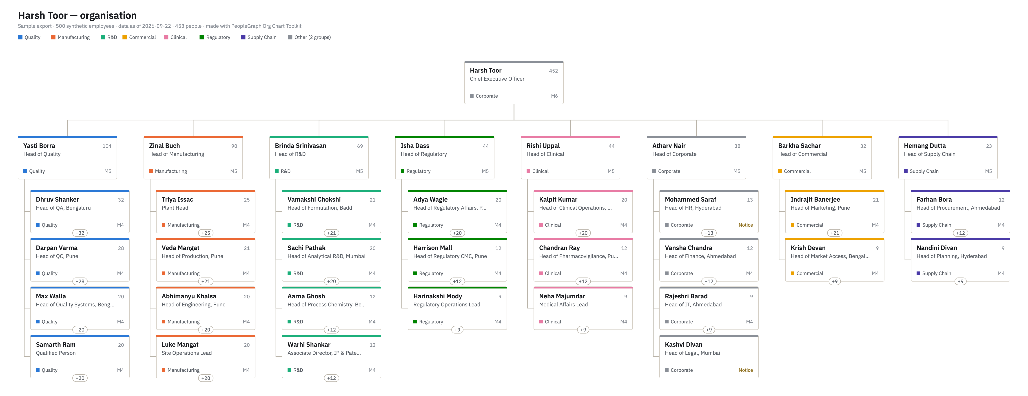
Harsh Toor — organisation
Sample export · 500 synthetic employees · data as of 2026-09-22 · 453 people · made with PeopleGraph Org Chart Toolkit

Slide 3
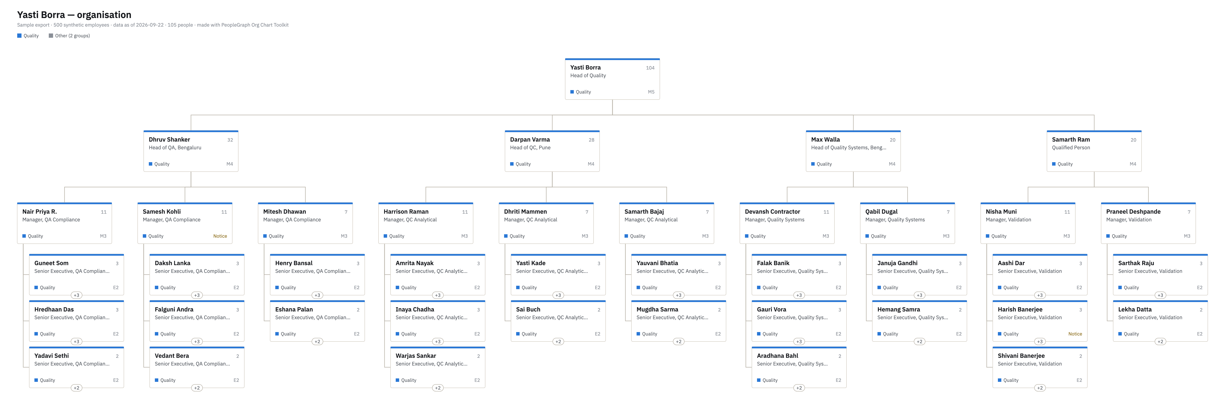
Yasti Borra — organisation
Sample export · 500 synthetic employees · data as of 2026-09-22 · 105 people · made with PeopleGraph Org Chart Toolkit

Slide 4
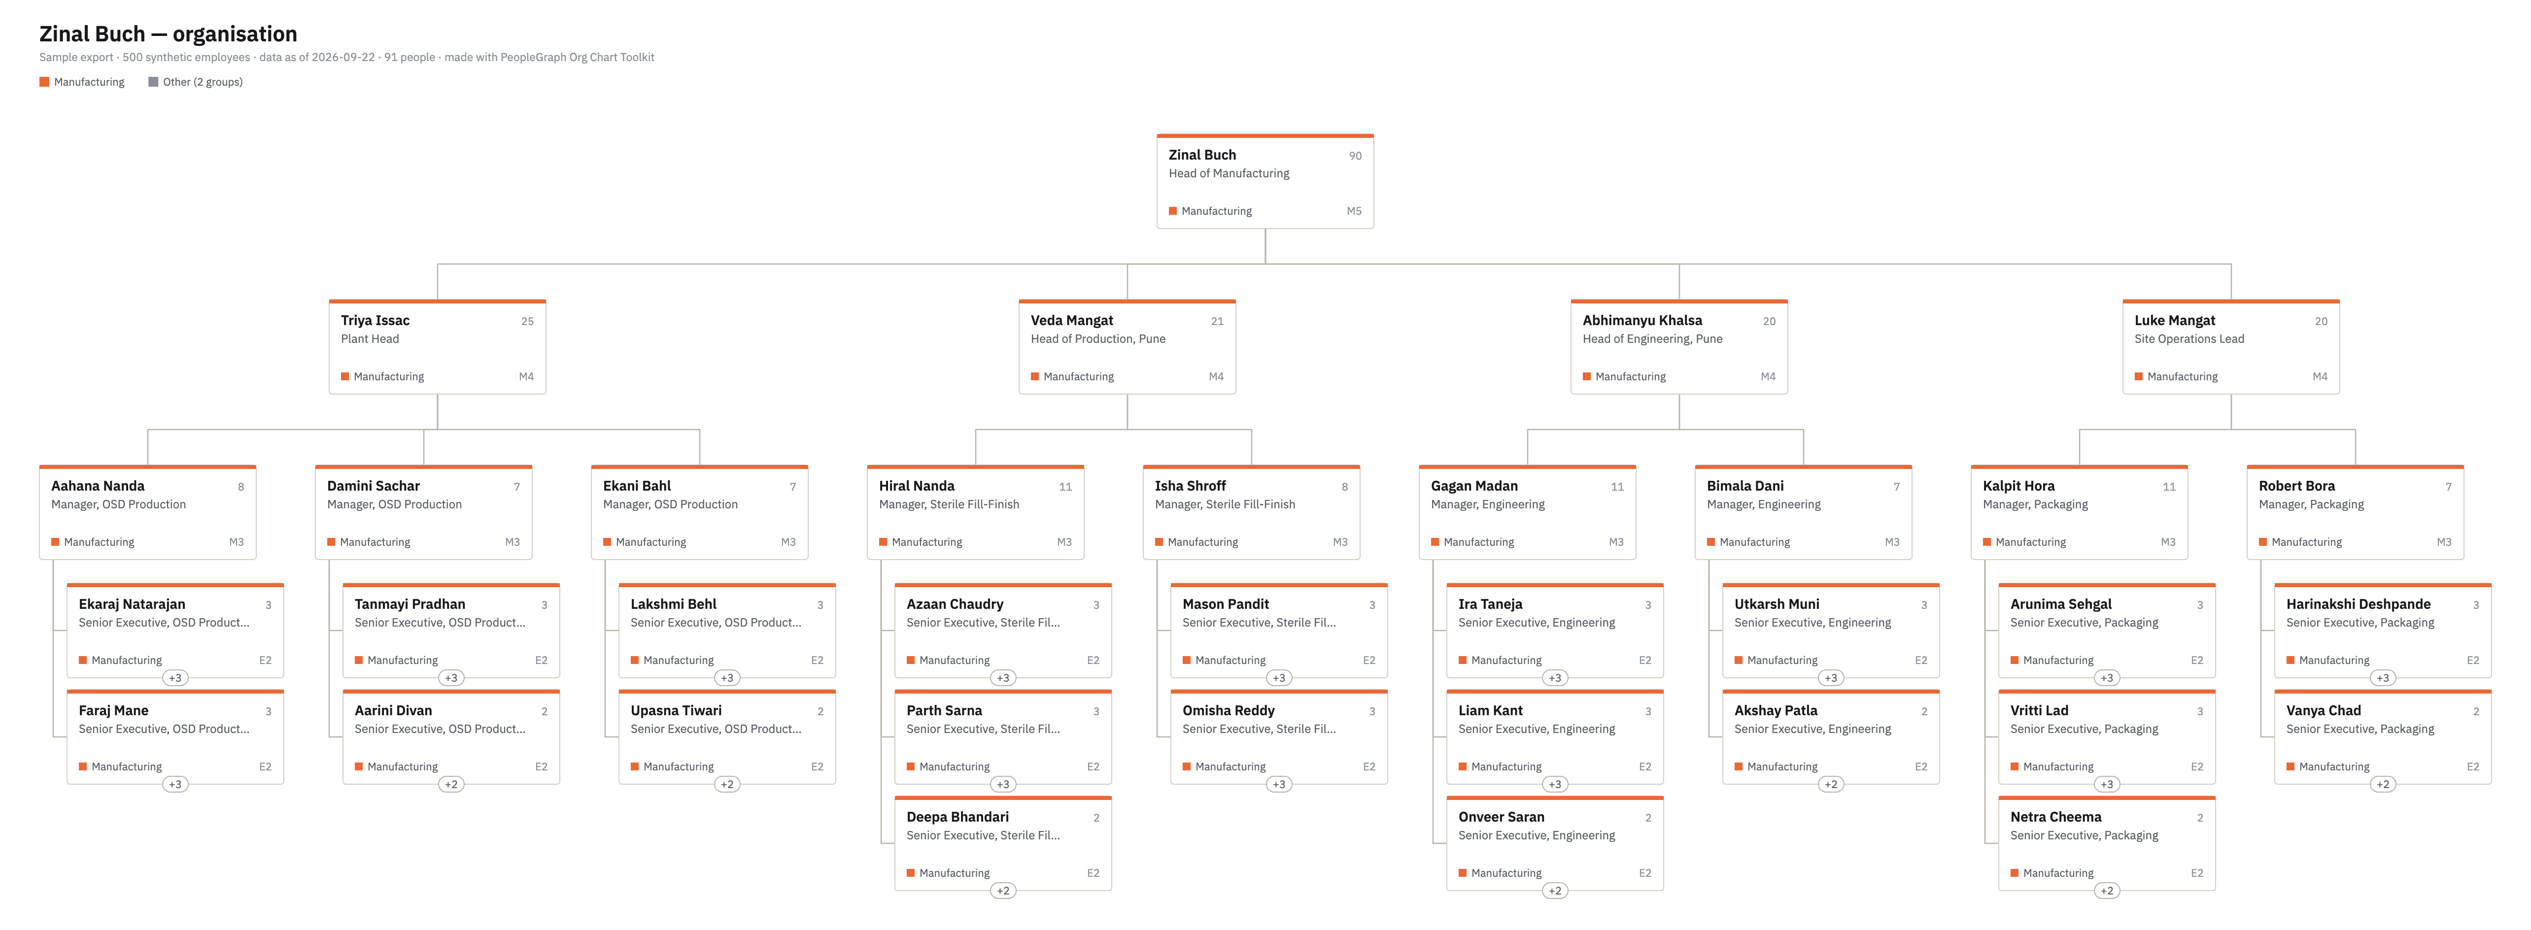
Zinal Buch — organisation
Sample export · 500 synthetic employees · data as of 2026-09-22 · 91 people · made with PeopleGraph Org Chart Toolkit

Slide 5
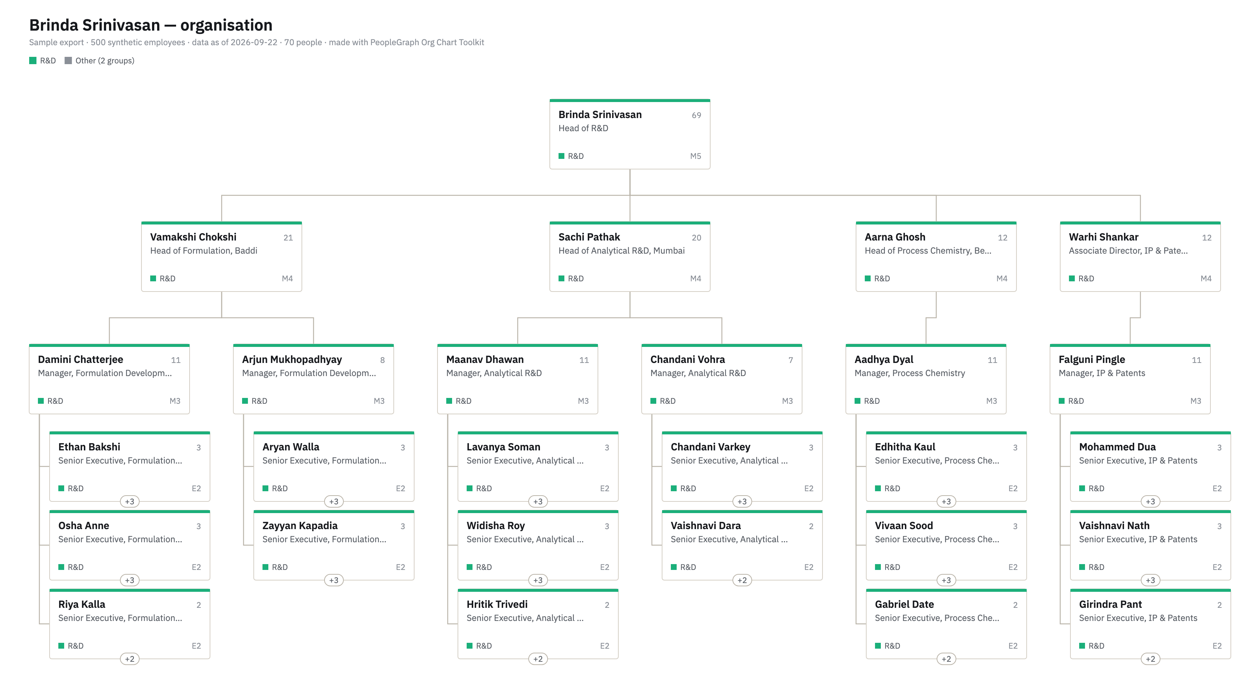
Brinda Srinivasan — organisation
Sample export · 500 synthetic employees · data as of 2026-09-22 · 70 people · made with PeopleGraph Org Chart Toolkit

Slide 6
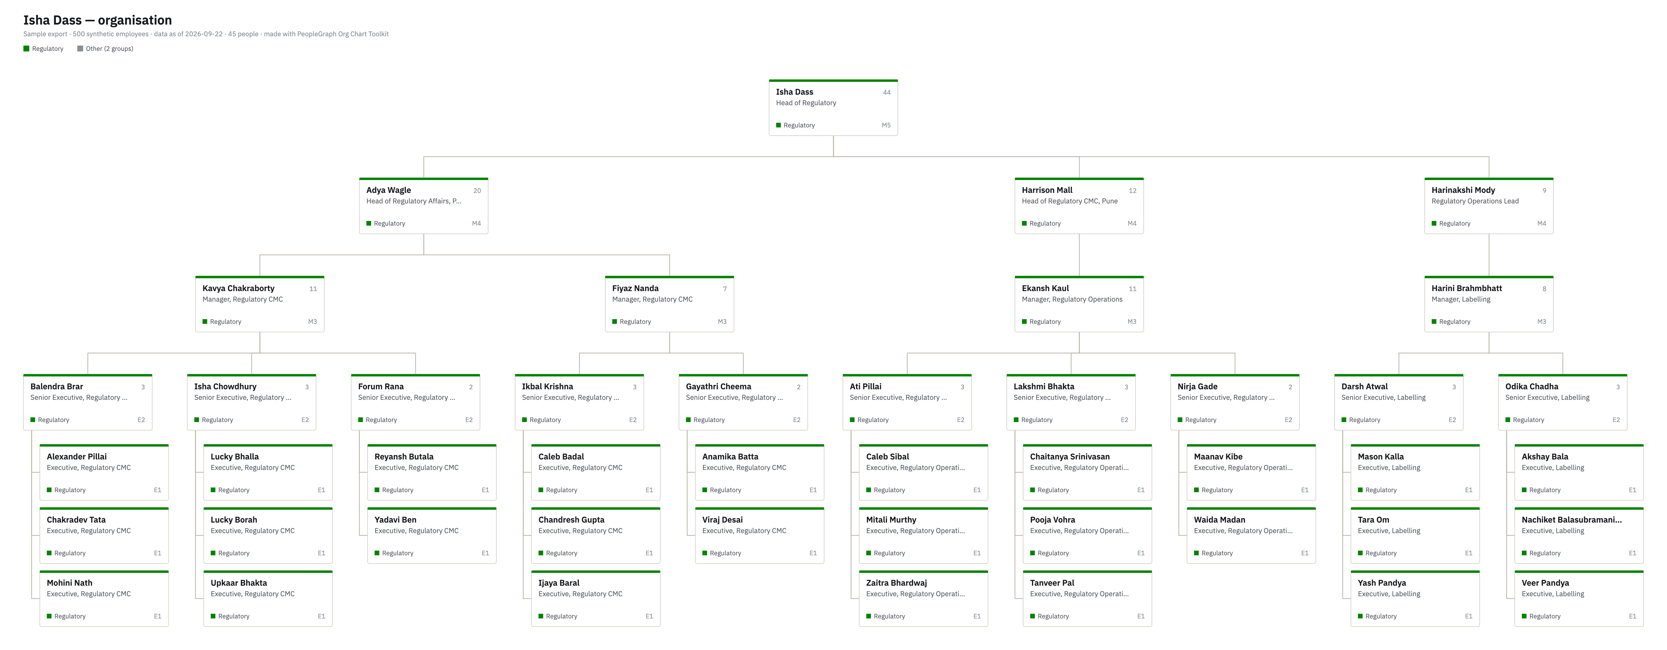
Isha Dass — organisation
Sample export · 500 synthetic employees · data as of 2026-09-22 · 45 people · made with PeopleGraph Org Chart Toolkit

Slide 7
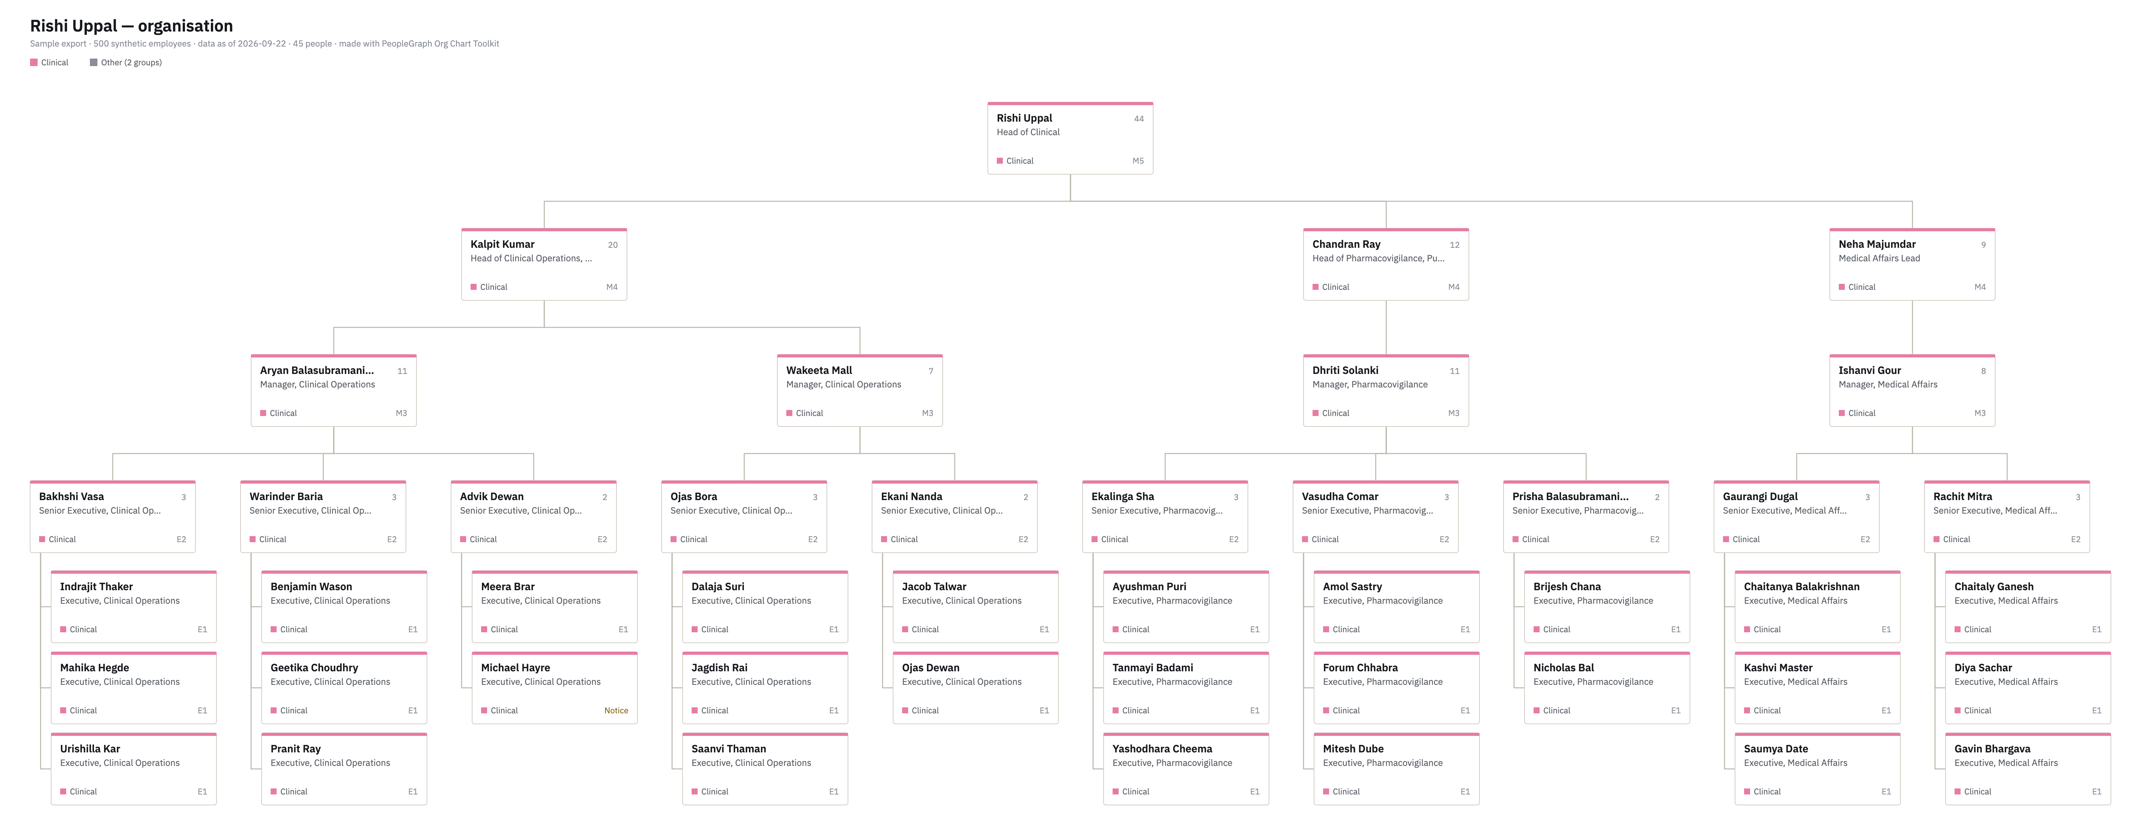
Rishi Uppal — organisation
Sample export · 500 synthetic employees · data as of 2026-09-22 · 45 people · made with PeopleGraph Org Chart Toolkit

Slide 8
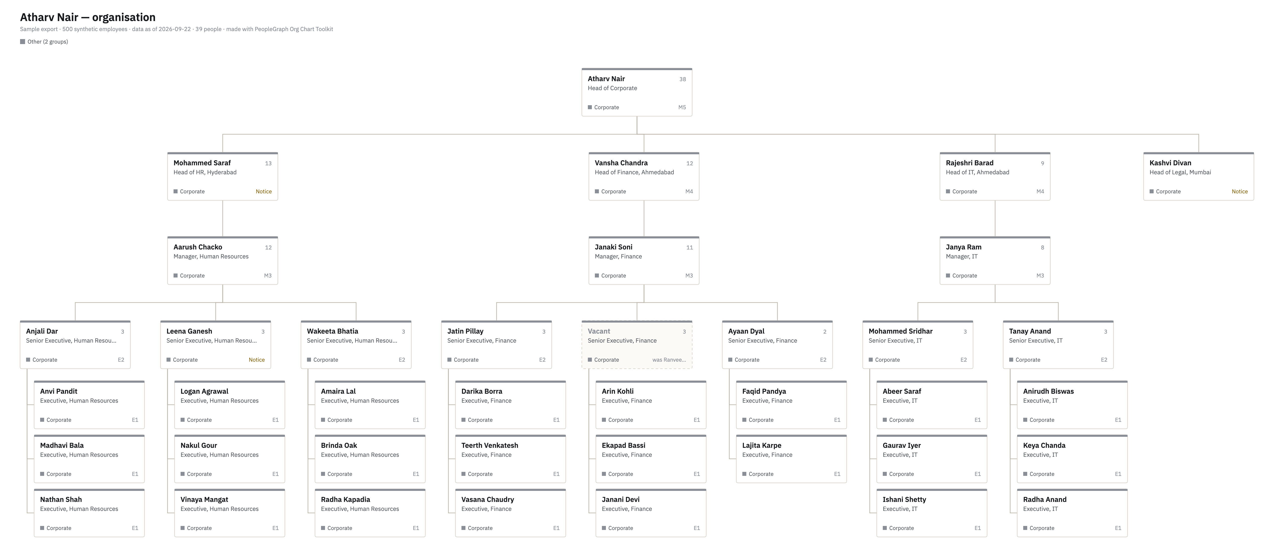
Atharv Nair — organisation
Sample export · 500 synthetic employees · data as of 2026-09-22 · 39 people · made with PeopleGraph Org Chart Toolkit

Slide 9
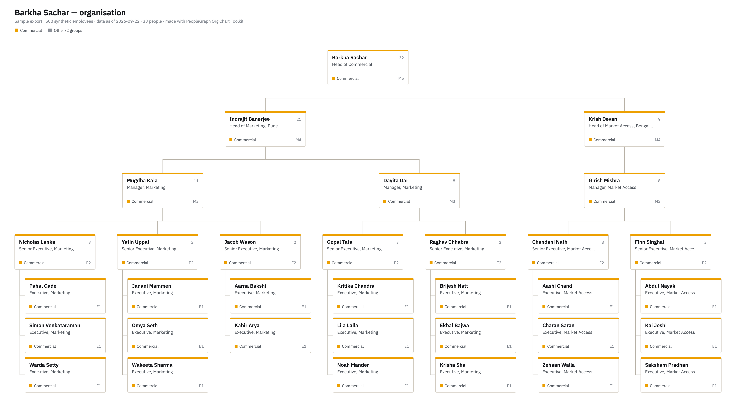
Barkha Sachar — organisation
Sample export · 500 synthetic employees · data as of 2026-09-22 · 33 people · made with PeopleGraph Org Chart Toolkit

Slide 10
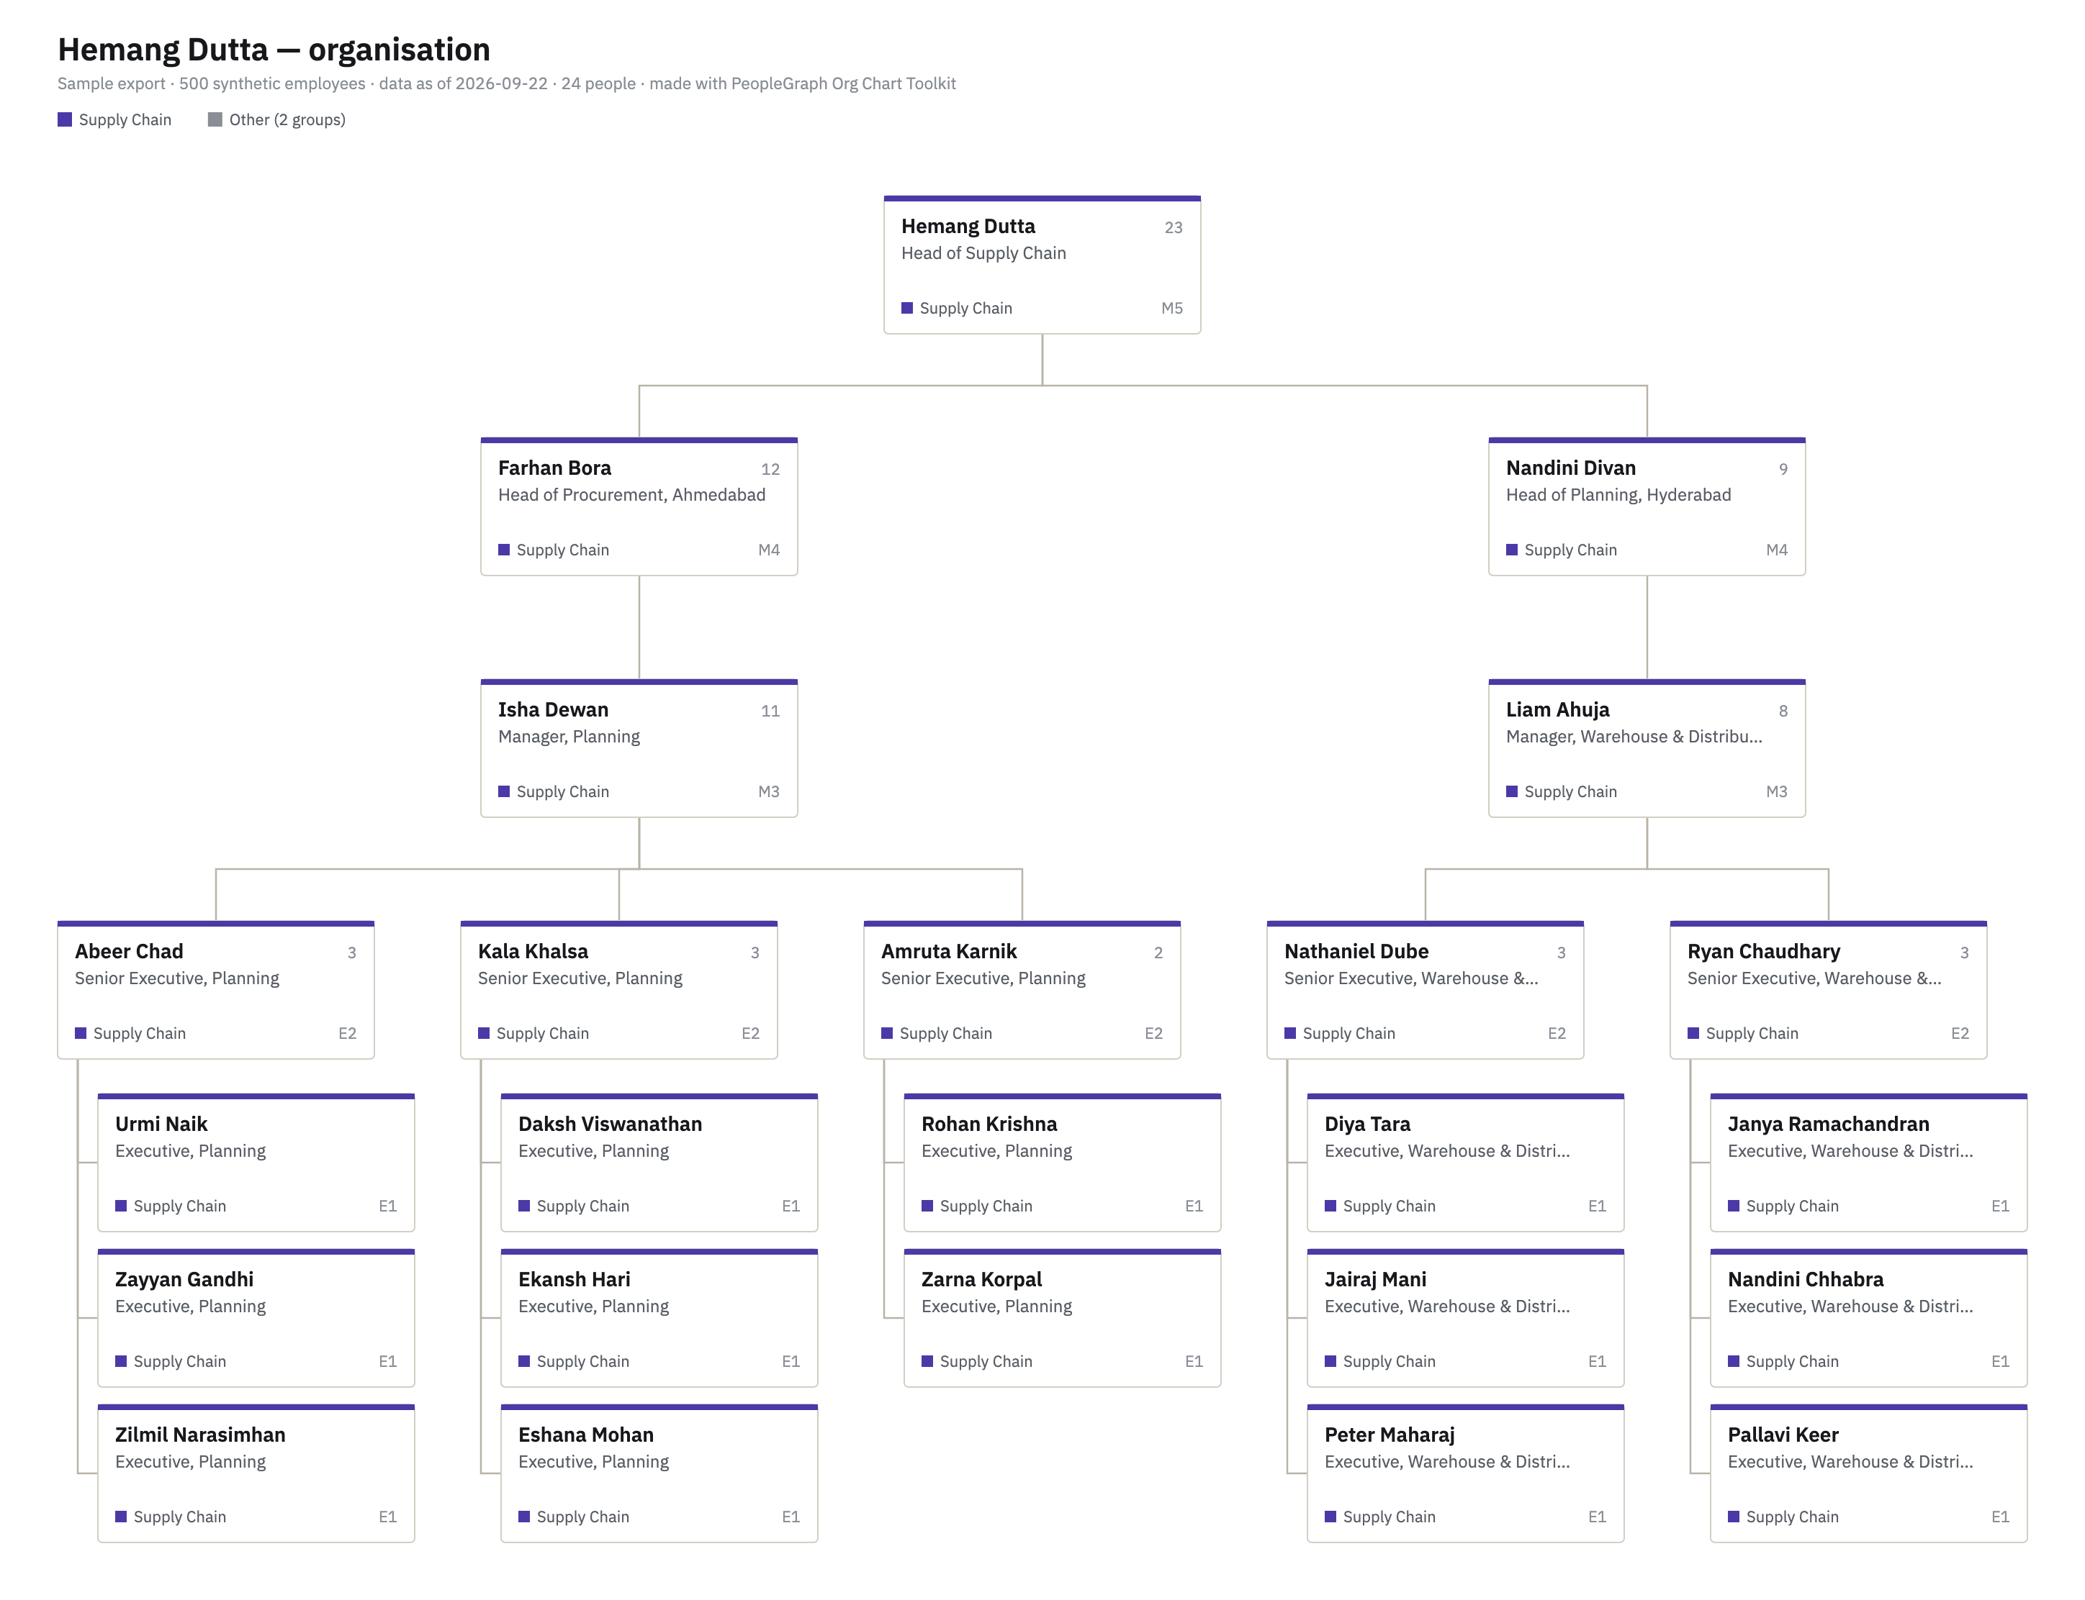
Hemang Dutta — organisation
Sample export · 500 synthetic employees · data as of 2026-09-22 · 24 people · made with PeopleGraph Org Chart Toolkit

Slide 11
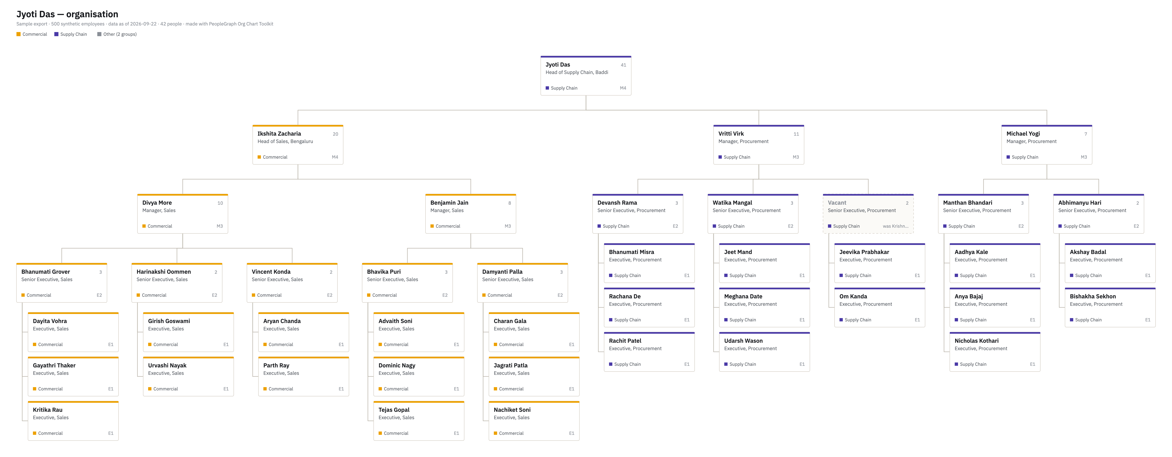
Jyoti Das — organisation
Sample export · 500 synthetic employees · data as of 2026-09-22 · 42 people · made with PeopleGraph Org Chart Toolkit

Slide 12
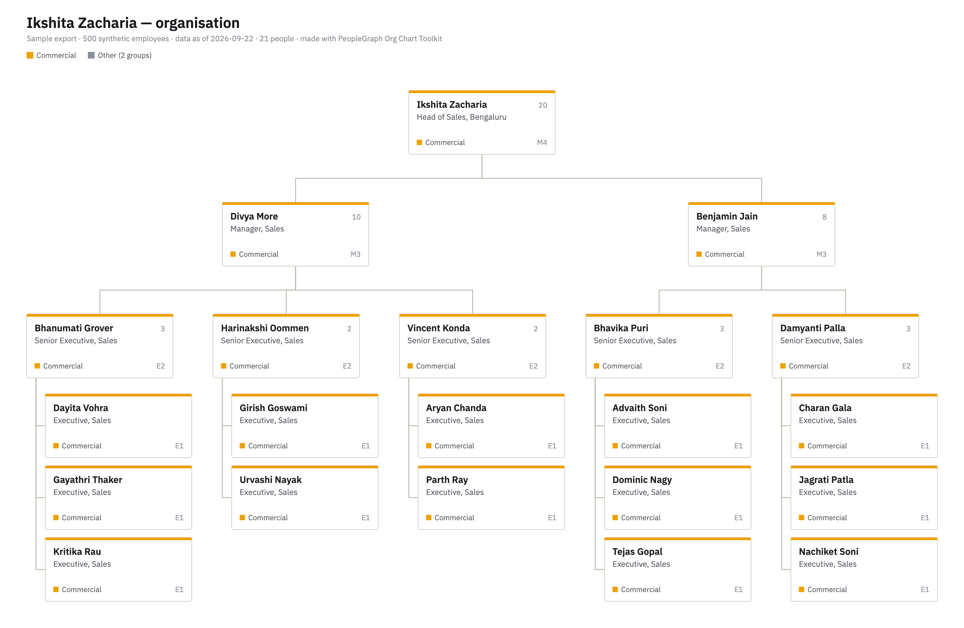
Ikshita Zacharia — organisation
Sample export · 500 synthetic employees · data as of 2026-09-22 · 21 people · made with PeopleGraph Org Chart Toolkit

Slide 13
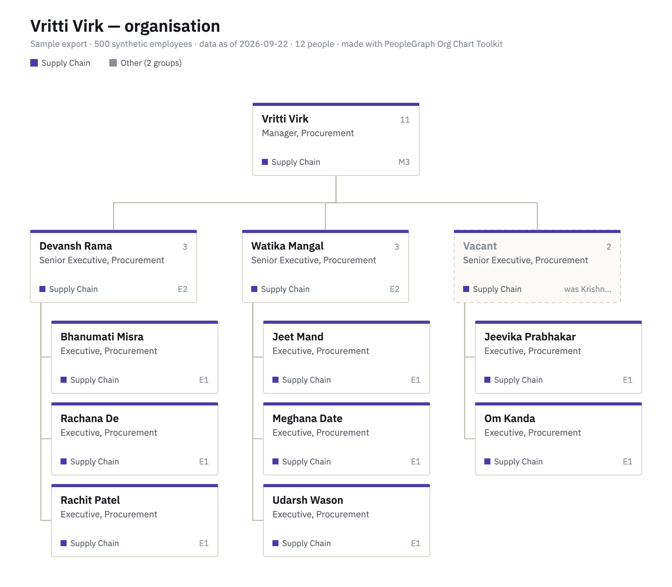
Vritti Virk — organisation
Sample export · 500 synthetic employees · data as of 2026-09-22 · 12 people · made with PeopleGraph Org Chart Toolkit

Slide 14
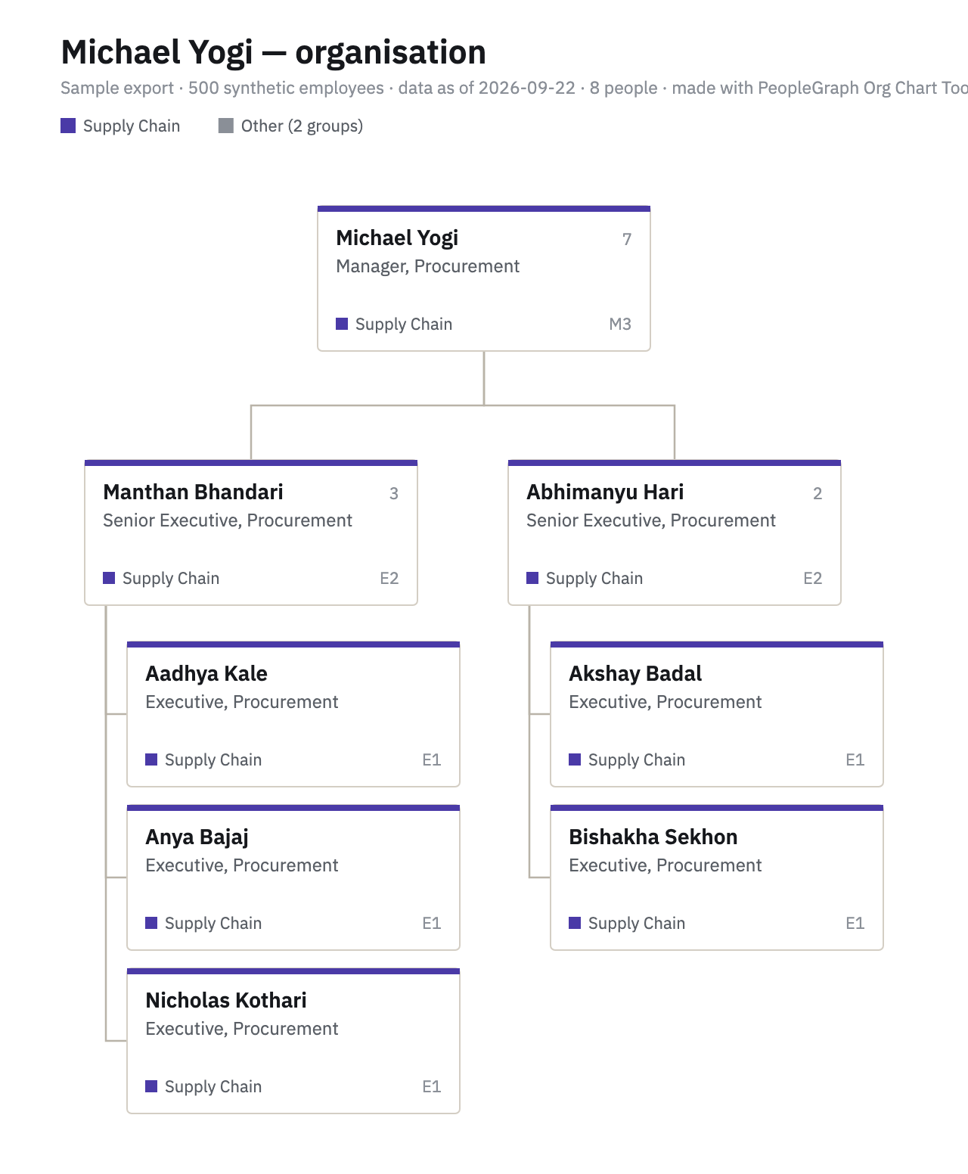
Michael Yogi — organisation
Sample export · 500 synthetic employees · data as of 2026-09-22 · 8 people · made with PeopleGraph Org Chart Toolkit

Slide 15
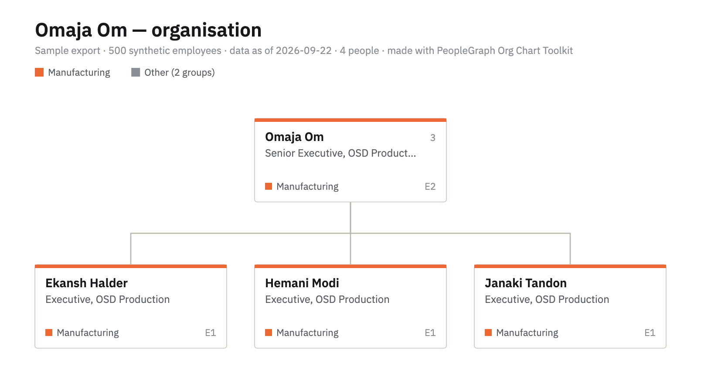
Omaja Om — organisation
Sample export · 500 synthetic employees · data as of 2026-09-22 · 4 people · made with PeopleGraph Org Chart Toolkit

